Slide 1
Stable dıffusıon
Ali Cenk Baytop

Slide 2
content
What is Generative Adversarial Network?​
Where to used GANs?
GANs vs Diffusion Models?
What is stable diffusion?

Slide 3
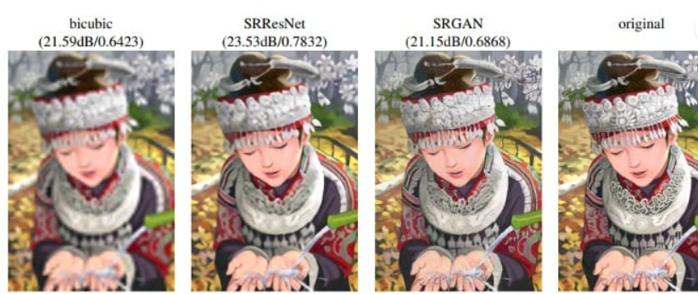
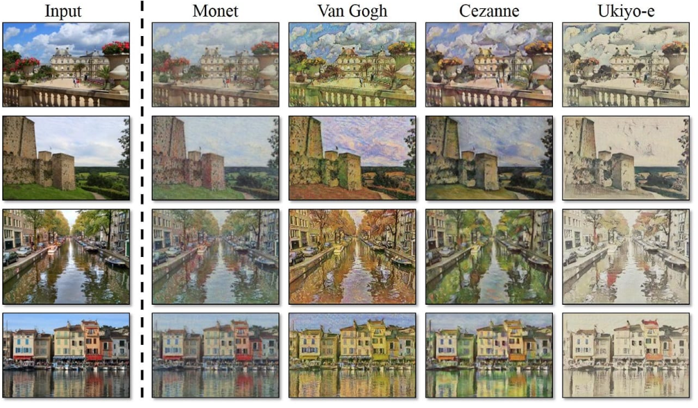
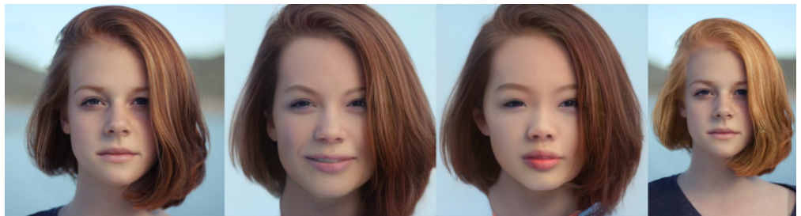
What ıs GANs?
Ian Goodfellow
Generative Adversarial Networks(2014)
1406.2661.pdf (arxiv.org)
Type of GANs:
-VanillaGAN
-DCGAN
-InfoGAN
-DiscoGAN
- SRGAN…

Slide 4
Where to used Gans?
Generate examples for Image Datasets
Image-to-Image Translation
Text-to-Image Translation
Semantic-Image-to-Photo Translation
Face Frontal View Generation
Generate New Human Poses
Photos to Emojis
Photograph Editing
Face Aging
Photo Blending
Super Resolution
Photo Inpainting
Clothing Translation
Video Prediction
3D Object Generation

Slide 5
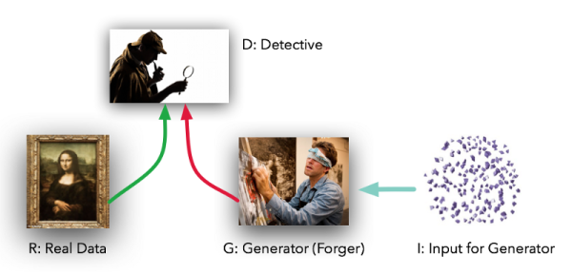
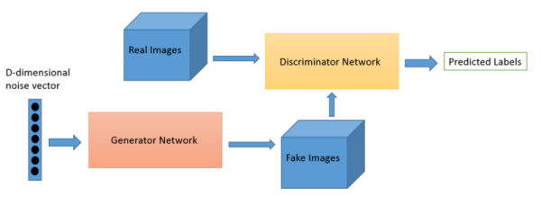
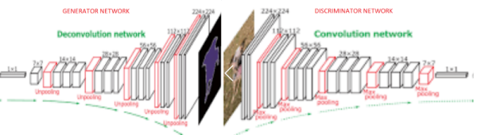

Slide 6
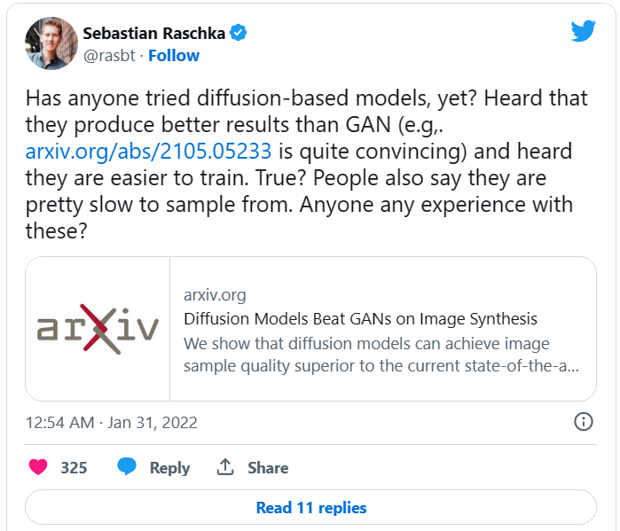
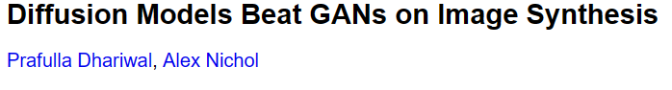
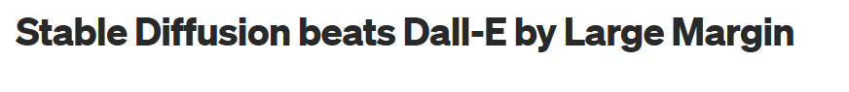
GANS vs dıffusıon models

Slide 7
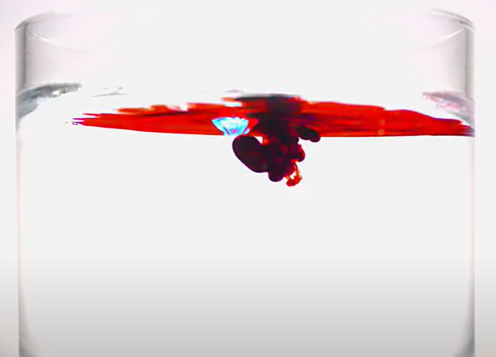
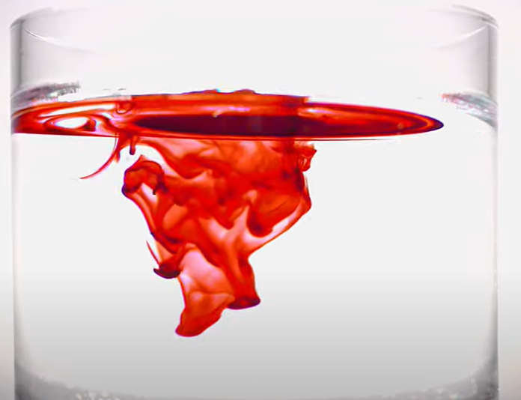
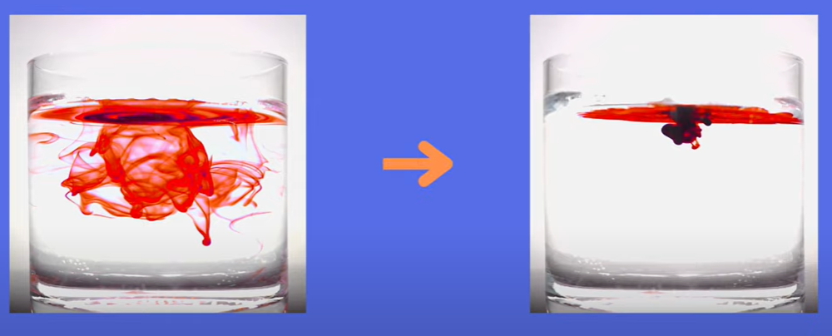
What ıs stable dıffusıon?
Inspired by Non-equilibrium thermodynamics(physics)
Latent Stable Diffusion
Stability AI, 22 August 2022, Open source
DALLE-2, Midjourney, etc.
Text to image
https://stability.ai/blog/stable-diffusion-public-release

Slide 8
- Markov chain: There are no cross dependencies between time steps that do not immediately follow each other. Tractable for noise adding

Slide 9
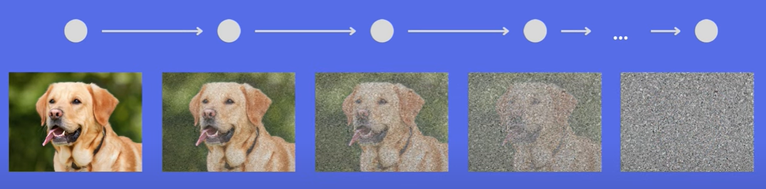
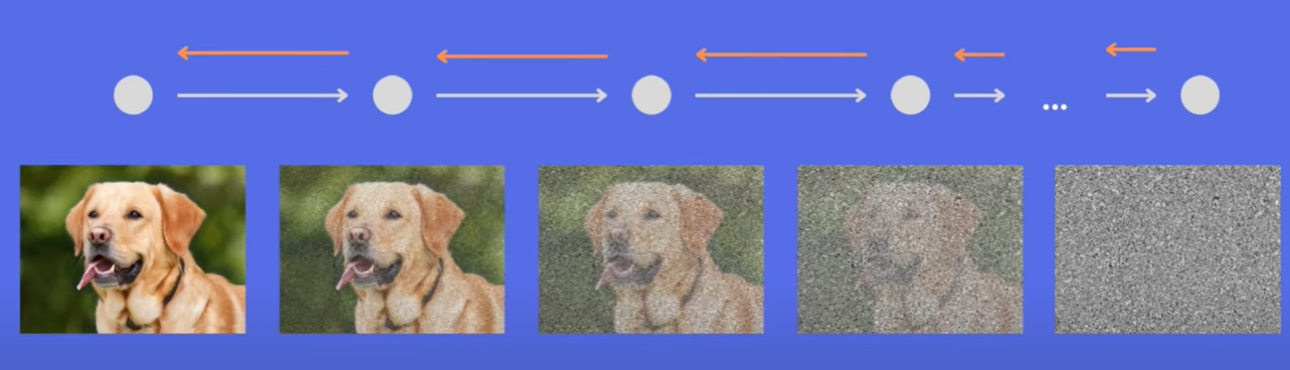
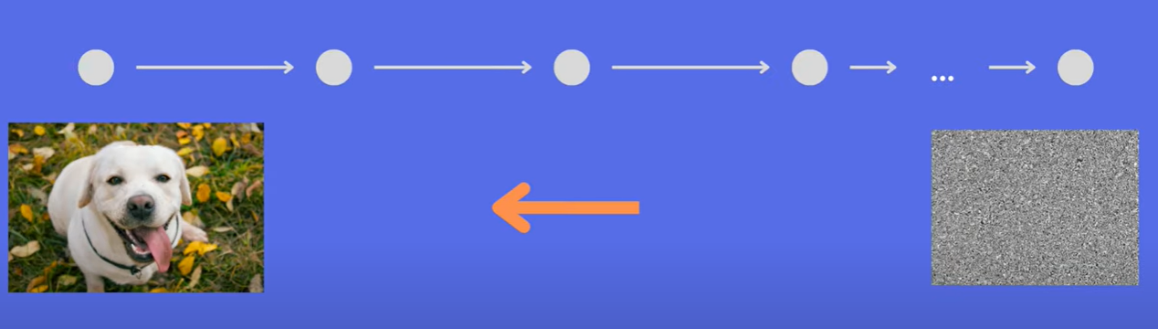
- Markov chain: There are no cross dependencies between time steps that do not immediately follow each other. Tractable for noise adding.

Slide 10
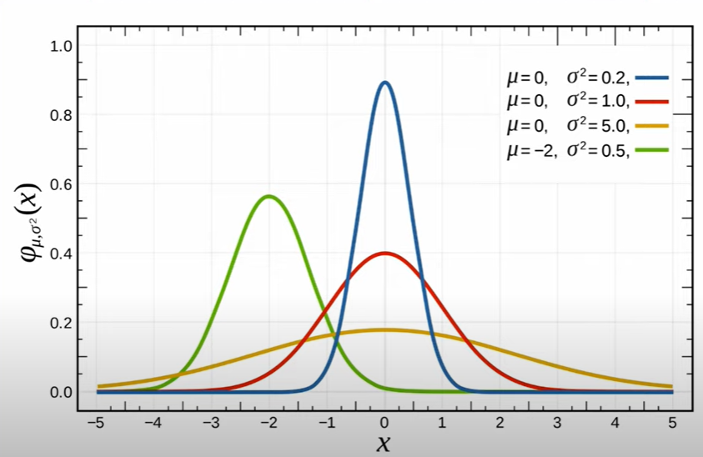
Gaussın noıse

Slide 11
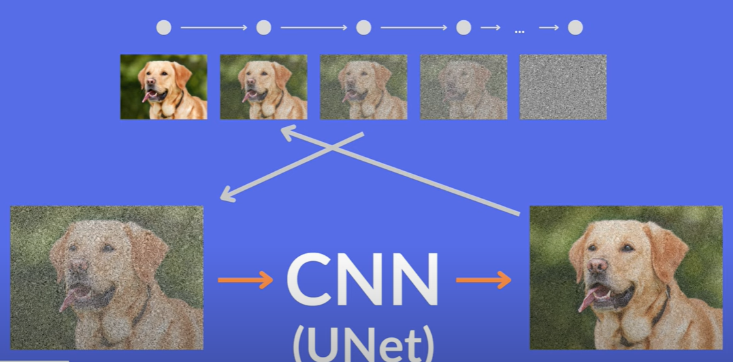
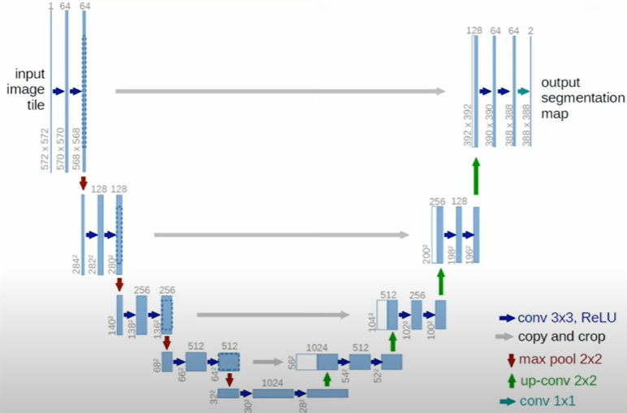

Slide 12
References
AI Coffee Break with Letitia
Two Minute Papers
AssemblyAI

Slide 13
THANK YOU
Ali Cenk Baytop
https://tr.linkedin.com/in/alicenkbaytop
https://medium.com/@alicenkbaytop

